Slide 1




Introduction to Computation
Autumn, 2023
Prof. Fan Cheng
Shanghai Jiao Tong University
chengfan85@gmail.com
https://github.com/ichengfan/itc

Slide 2
Outline
Randomness
Unicode
File processing
12

Slide 3
Randomness

Slide 4


Random number
“God does not play dice with the universe.”
-- Einstein
To play a game of chance where the computer needs to throw some dice, pick a number, or flip a coin
To shuffle a deck of playing cards randomly
To allow/make an enemy spaceship appear at a random location and start shooting at the player
To simulate possible rainfall when we make a computerized model for estimating the environmental impact of building a dam
For encrypting banking sessions on the Internet
Integers: uniform distributed, random permutation, random sampling
Real numbers: uniform, Gaussian
https://docs.python.org/3/library/random.html
import random # py module

Slide 5
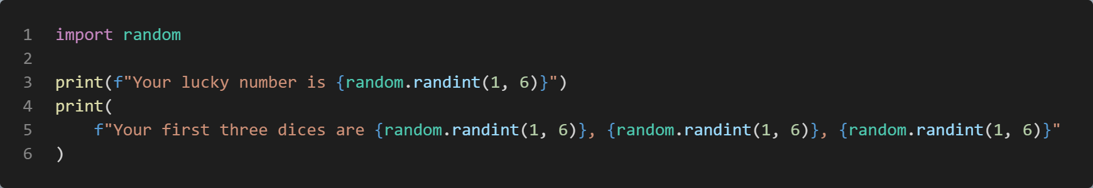
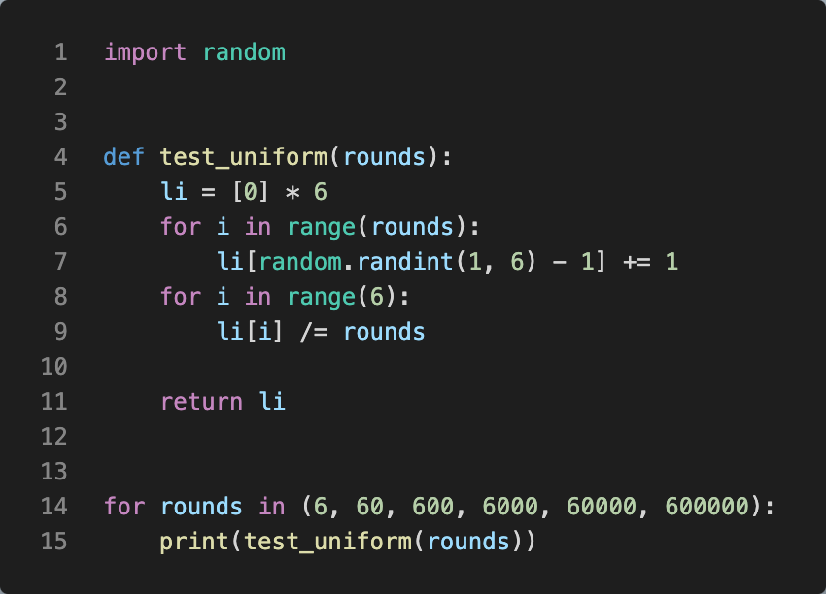
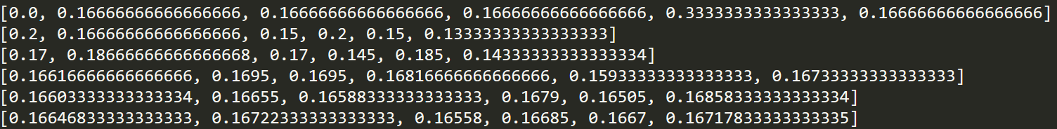
Random integer
random.randint(a, b): Return a random integer N such that a <= N <= b
As rounds grows, the probability goes to 1/6∼0.166

Slide 6
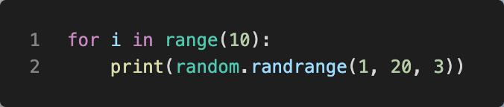

Random integer(cont’d)
random.randrange(start, stop, step):
Return a randomly selected element from range(start, stop, step)
random.randrange(stop)
Recall: range(a, b) = [a, b) (b is not included!)
Random.randit(a, b) = random.randrange(a, b+1)

Slide 7
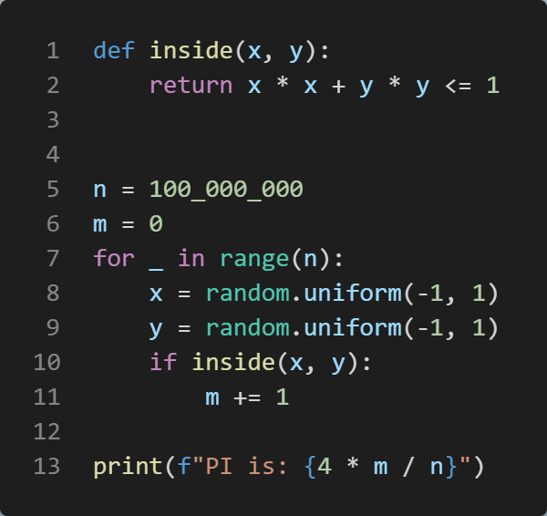
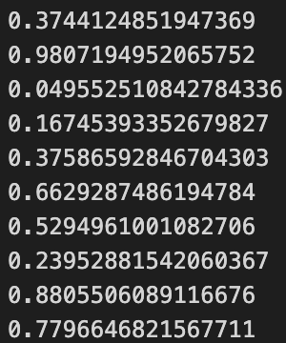
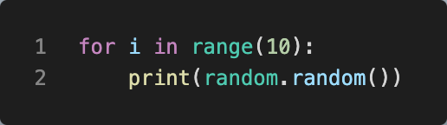
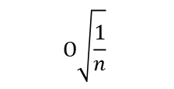
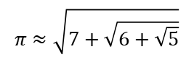
Random floating number
random.random() Return the next random floating point number in the range [0.0, 1.0).
random.uniform(a, b) Return a random floating point number N such that a <= N <= b for a <= b and b <= N <= a for b < a.
The end-point value b may or may not be included in the range depending on floating-point rounding in the equation a + (b-a) * random()
Exercise: Compute Pi = 3.1415926≈3.14
$$O\sqrt{\frac{1}{n}}$$
$$π≈\sqrt{7+\sqrt{6+\sqrt{5}}}$$

Slide 8
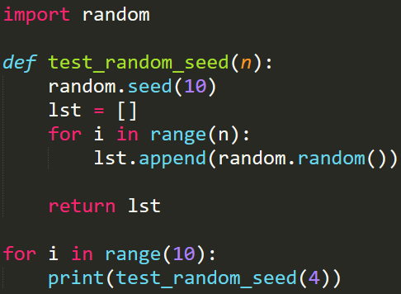
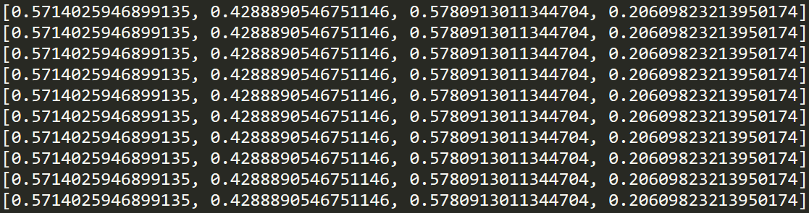
Seed (随机数种子)
The random.seed() method is used to initialize the random number generator
The random number generator needs a number to start with (a seed value), to be able to generate a random number
By default the random number generator uses the current system time
Use the seed() method to customize the start number of the random number generator
If you use the same seed value twice you will get the same random number twice
仿真实验需要

Slide 9
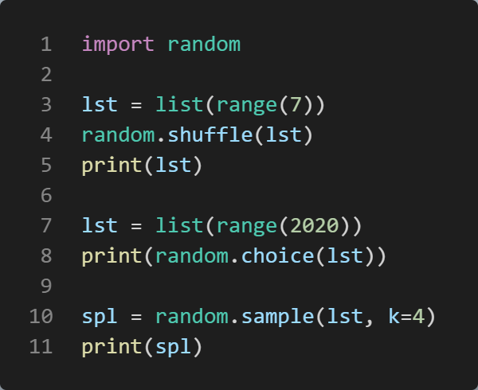
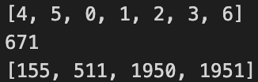
Random: choice(), shuffle(), sample()
random.choice(): Return a random element from the non-empty sequence seq
random.choices(population, weights=None, *, cum_weights=None, k=1): Return a k sized list of elements chosen from the population with replacement
random.shuffle(): Shuffle the sequence x in place
random.sample(): Return a k length list of unique elements chosen from the population sequence or set

Slide 10

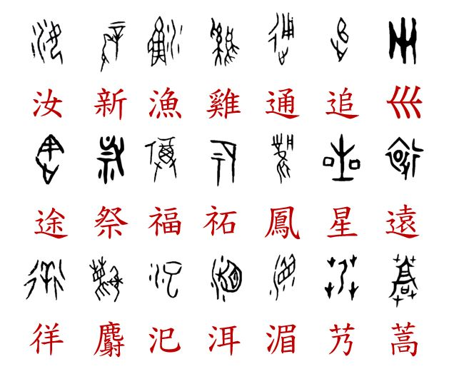
Unicode

Slide 11

Information Coding Standard
Computers can only “understand” binary information {0, 1}.
Everything inside is represented as a binary sequence.
A binary sequence is of no meaning unless we translate it to the human text
In program, information could be stored at Memory and Files.
Memory information will be erased after the process is finished, while files are permeant.
Files are stored as 0, 1 sequences.
In principle, we have infinitely many explanation a sequence like 0011011.
We need to share a standard
ASCII is the standard to represent only English information with only 128 characters.
We need a standard to process Chinese, Arab, French and so on
Unicode, formally The Unicode Standard, is a text encoding standard maintained by the Unicode Consortium designed to support the use of text written in all of the world's major writing systems

Slide 12

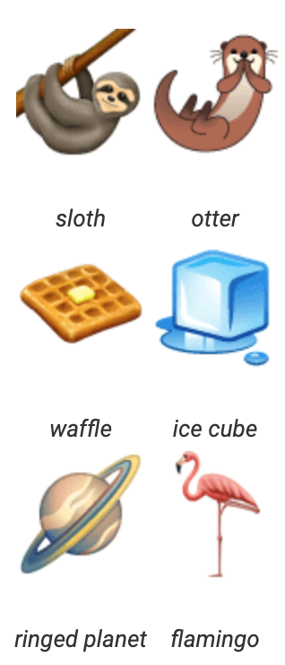
Unicode and UTF8
Version 15.1 of the standard defines 149,813 characters and 161 scripts used in various ordinary, literary, academic, and technical contexts.
Moreover, the widespread adoption of Unicode was in large part responsible for the initial popularization of emoji (表情符号) outside of Japan. Unicode is ultimately capable of encoding more than 1.1 million characters.
The first 128 characters in the Unicode table correspond precisely to the ASCII characters that you’d reasonably expect them to.
Unicode itself is not an encoding. Rather, Unicode is implemented by different character encodings.
Unicode doesn’t tell you how to get actual bits from text—just code points. It doesn’t tell you enough about how to convert text to binary data and vice versa.
Unicode is an abstract encoding standard, not an encoding
UTF-8 as well as its lesser-used cousins, UTF-16 and UTF-32, are encoding formats for representing Unicode characters as binary data of one or more bytes per character.
Unicode 规定了所有字符的序号，但这个序号不代表编码。譬如学生的序号和学号不是一样的。编码设计是一个复杂的问题，就要考虑时间效率，也要考虑空间占用率
Emoji Frequency
https://en.wikipedia.org/wiki/Unicode https://home.unicode.org/

Slide 13
Bytes and Bytearray
The core built-in types for manipulating binary data are bytes and bytearray
btxt = b’hello world’
Bytes objects are immutable sequences of single bytes. The syntax for bytes literals is largely the same as that for string literals, except that a b prefix is added
class bytes([source[, encoding[, errors]]])
Only ASCII characters are permitted in bytes literals (regardless of the declared source code encoding). Any binary values over 127 must be entered into bytes literals using the appropriate escape sequence. (\b \o \x)
As with string literals, bytes literals may also use a r prefix to disable processing of escape sequences
Since 2 hexadecimal digits correspond precisely to a single byte, hexadecimal numbers are a commonly used format for describing binary data
classmethod fromhex(string)
This bytes class method returns a bytes object, decoding the given string object. The string must contain two hexadecimal digits per byte, with ASCII whitespace being ignored
hex([sep[, bytes_per_sep]])
Return a string object containing two hexadecimal digits for each byte in the instance
bytearray objects are a mutable counterpart to bytes objects
class bytearray([source[, encoding[, errors]]])
str and bytes have almost identical functionality
https://docs.python.org/3/library/stdtypes.html#binary-sequence-types-bytes-bytearray-memoryview

Slide 14
Bytes and Bytearray
The core built-in types for manipulating binary data are bytes and bytearray
btxt = b'你好世界'
Bytes 对象是单个字节的不可变序列。bytes 文本的语法与字符串文本的语法大致相同，只是添加了 b 前缀
类字节（[源代码[， 编码[， 错误]]]）
字节文本中只允许使用 ASCII 字符（无论声明的源代码编码如何）。任何超过 127 的二进制值都必须使用适当的转义序列输入到字节文本中。（b o x）
与字符串文本一样，字节文本也可以使用 r 前缀来禁用转义序列的处理
由于 2 个十六进制数字精确对应于单个字节，因此十六进制数是描述二进制数据的常用格式
ClassMethod fromHex（String）
此 bytes 类方法返回一个 bytes 对象，对给定的字符串对象进行解码。字符串必须包含每个字节两个十六进制数字，并忽略 ASCII 空格
十六进制（[sep[， bytes_per_sep]]）
返回一个字符串对象，该对象包含实例中每个字节的两个十六进制数字
ByteArray 对象是 bytes 对象的可变对应对象
类 ByteArray（[源代码[， 编码[， 错误]]]）
str 和 bytes 具有几乎相同的功能
https://docs.python.org/3/library/stdtypes.html#binary-sequence-types-bytes-bytearray-memoryview

Slide 15
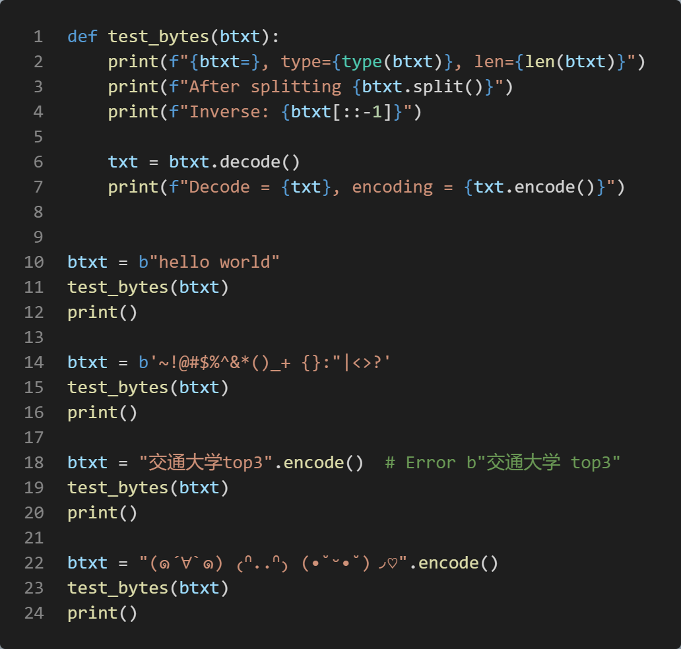

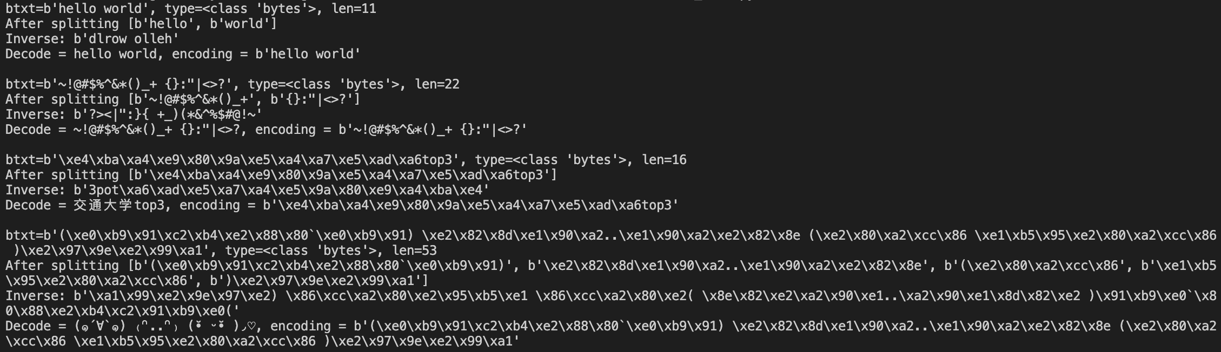
Bytes Examples
Python 3 的 str 类型旨在表示人类可读的文本，可以包含任何 Unicode 字符
相反，bytes 类型表示二进制数据或原始字节序列，它们本质上没有附加编码。在 .encode（） 和 .decode（） 中，编码参数默认为“utf-8”，尽管指定它通常更安全、更明确
str—bytes: encode()—decode()
Python 3’s str type is meant to represent human-readable text and can contain any Unicode character
The bytes type, conversely, represents binary data, or sequences of raw bytes, that do not intrinsically have an encoding attached to it.
In .encode() and .decode(), the encoding parameter is "utf-8" by default, though it’s generally safer and more unambiguous to specify it(encode变成16进制编码，decode变成string.)
bytes给计算机看，str给人看

Slide 16
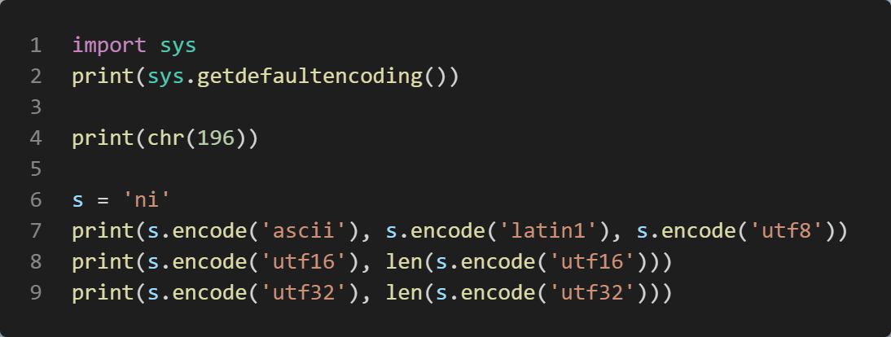
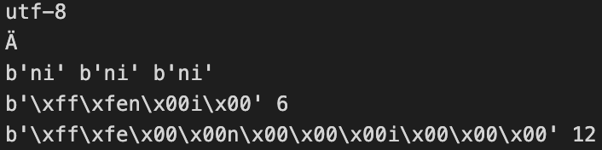
UTF8
在 Latin-1 中，高于 127 的字符代码分配给重音字符和其他特殊字符。
UTF-8 编码：小于 128 的字符代码表示为单个字节;128 和 0x7ff （2047） 之间的代码转换为 2 个字节，其中每个字节的值介于 128 和 255 之间;高于 0x7ff 的代码将转换为值介于 128 和 255 之间的 3 字节或 4 字节序列。
UTF-16 和 UTF-32 格式文本，每个字符方案分别具有固定大小的 2 或 4 个字节和 4 个字节，即使对于本来可以容纳在单个字节中的字符也是如此。
In Latin-1, character codes above 127 are assigned to accented and otherwise special characters.
UTF-8 encoding: Character codes less than 128 are represented as a single byte; codes between 128 and 0x7ff (2047) are turned into 2 bytes, where each byte has a value between 128 and 255; and codes above 0x7ff are turned into 3- or 4-byte sequences having values between 128 and 255.
UTF-16 and UTF-32 format text with a fixed-size 2 or 4 bytes and 4 bytes per each character scheme, respectively, even for characters that could otherwise fit in a single byte.
\xff\xfe thing is the byte order mark (BOM), used to indicate the endianness (大小端) of the data.
Big endian and little endian: Big-endian is an order in which the "big end" (most significant value in the sequence) is stored first, at the lowest storage address. Little-endian is an order in which the "little end" (least significant value in the sequence) is stored first.

Slide 17
Coding Unicode Strings
To code arbitrary Unicode characters in your strings, some of which you might not even be able to type on your keyboard, Python string literals support both "\xNN" hex byte value escapes and "\uNNNN" and "\UNNNNNNNN" Unicode escapes in string literals.
In Unicode escapes, the first form gives four hex digits to encode a 2-byte (16-bit) character code point, and the second gives eight hex digits for a 4-byte (32-bit) code point.
Byte strings support only hex escapes for encoded text and other forms of byte-based data.
"\N{name}" Character named name in the Unicode database"\N{LATIN SMALL LETTER A}“
Useful Functions
ascii()
bin()
bytes()
chr()
hex()
int()
oct()
ord()
str()
要在字符串中对任意 Unicode 字符进行编码，其中一些字符甚至可能无法在键盘上键入，Python 字符串文字支持字符串文字中的“xNN”十六进制字节值转义以及“uNNNN”和“UNNNNNNNN”Unicode 转义。
在 Unicode 转义中，第一种形式提供 4 位十六进制数字来编码 2 字节（16 位）字符码位，第二种形式提供 8 位十六进制数字来编码 4 字节（32 位）码位。
字节字符串仅支持编码文本和其他形式的基于字节的数据的十六进制转义。
“N{name}” Unicode 数据库中名为 name 的字符 “N{拉丁文小写字母 A}”
https://docs.python.org/3/library/unicodedata.html
https://home.unicode.org/
https://symbl.cc/en/

Slide 18
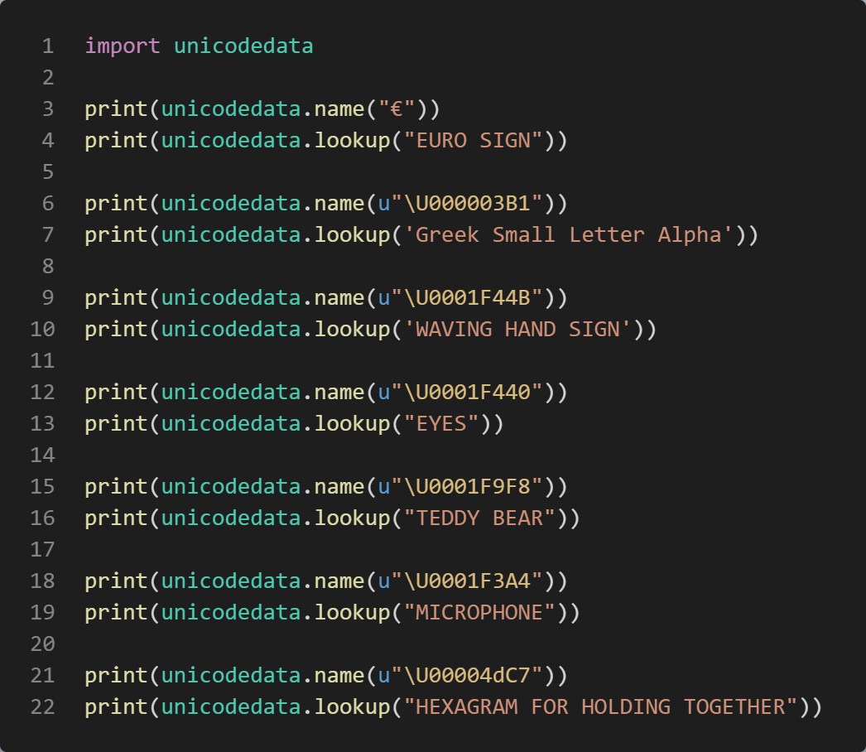
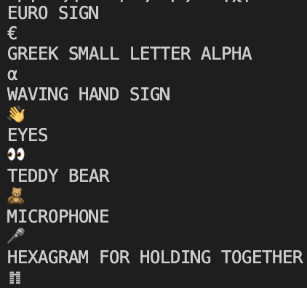
unicodedata — Unicode Database
This module provides access to the Unicode Character Database (UCD) which defines character properties for all Unicode characters.
unicodedata.lookup(name)
unicodedata.name()
此模块提供对 Unicode 字符数据库 （UCD） 的访问，该数据库定义所有 Unicode 字符的字符属性。
UnicodeData.Lookup(名称)
unicodedata.name（u“编码”）

Slide 19
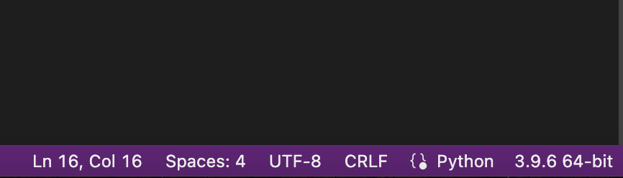
Source File Character Set Encoding Declarations
Finally, Unicode escape codes are fine for the occasional Unicode character in string literals, but they can become tedious if you need to embed non-ASCII text in your strings frequently.
To interpret the content of strings you code and hence embed within the text of your script files, Python uses the UTF-8 encoding by default, but it allows you to change this to support arbitrary character sets by including a comment that names your desired encoding.
The comment must be of this form and must appear as either the first or second line in your script in either Python 2.X or 3.X:
# -*- coding: latin-1 -*-
When a comment of this form is present, Python will recognize strings represented natively in the given encoding.
This means you can edit your script file in a text editor that accepts and displays accented and other non-ASCII characters correctly, and Python will decode them correctly in your string literals
VS Code right corner

Slide 20
Source File Character Set Encoding Declarations
最后，Unicode 转义码适用于字符串文字中偶尔出现的 Unicode 字符，但如果您需要经常在字符串中嵌入非 ASCII 文本，它们可能会变得乏味。
为了解释您编码的字符串的内容，从而嵌入到脚本文件的文本中，Python 默认使用 UTF-8 编码，但它允许您通过包含命名所需编码的注释来更改它以支持任意字符集。
注释必须采用以下形式，并且必须在 Python 2.X 或 3.X 的脚本中显示为第一行或第二行：
# -*- 编码：拉丁语-1 -*-
当存在这种形式的注释时，Python 将识别以给定编码原生表示的字符串。
这意味着您可以在文本编辑器中编辑脚本文件，该编辑器正确接受和显示重音字符和其他非 ASCII 字符，Python 将在字符串文字中正确解码它们
VS Code right corner

Slide 21

File processing

Slide 22
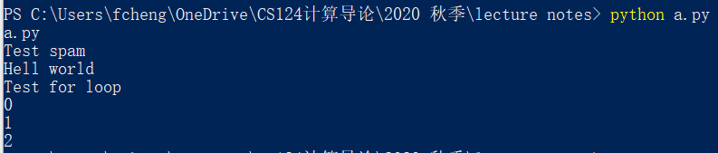

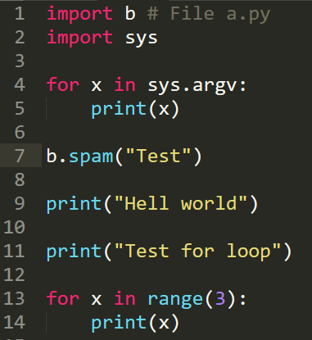
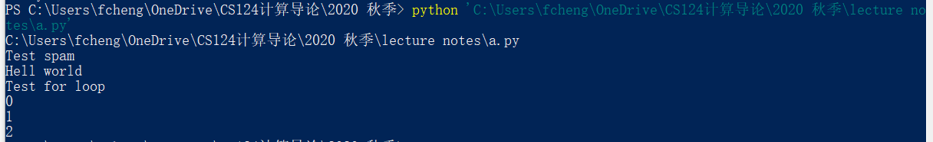
Shell
An absolute path (绝对路径), which always begins with the root folder (C:\windows\....\a.txt)
A relative path (相对路径), which is relative to the program’s current working directory (.\a\b.txt)
Run python program via shell: python filename.py
filename.py should be in the current working directory (当前工作目录)
Or python C:\xxxx\....\filename.py (绝对路径)
绝对路径 VS 相对路径
Shell中，路径名有空格用‘’包起来处理

Slide 23
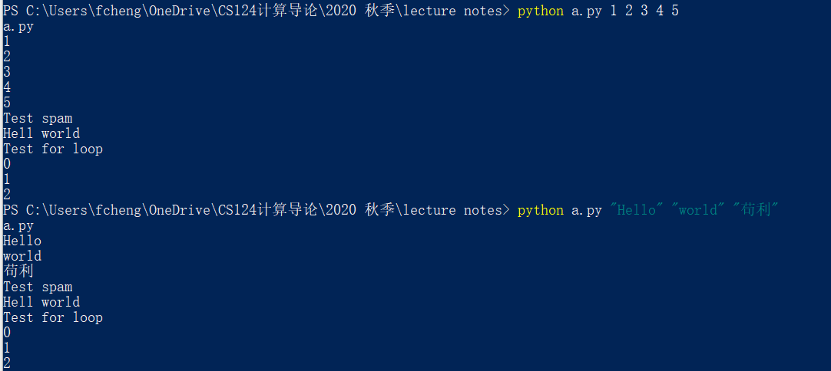
Shell: parameter
python filename.py parameter1 parameter2 parameter3 …
Run python program via shell with parameters:
如果出现shell错误，检查python文件是否在当前目录

Slide 24

Ubuntu
计算机方向的本科生一定要尽早接触Linux
https://ubuntu.com/
练习用它来替代windows做一切事情: 写报告，写代码等等
C++
Python
Shell
Office等等
开源: 没什么比源码更重要了
可以在windows下面装: 虚拟机+ubuntu
Mac和Linux用起来差距不大
打开一个美丽新世界
自己寒假折腾

Slide 25
Module sys
This module provides access to some variables used or maintained by the interpreter and to functions that interact strongly with the interpreter. It is always available
Manipulate different parts of the Python runtime environment
sys.version: This attribute displays a string containing the version number of the current Python interpreter
sys.argv: sys.argv returns a list of command line arguments passed to a Python script.
sys.path: This is an environment variable that is a search path for all Python modules.
sys.path[0]: current directory of the file
sys.exit: This causes the script to exit back to either the Python console or the command prompt. This is generally used to safely exit from the program in case of generation of an exception.
sys.maxsize: Returns the largest integer a variable can take.
sys.stdin, sys.stdout and sys.stderr: Standard data streams
https://docs.python.org/3/library/sys.html
https://www.python-course.eu/sys_module.php

Slide 26
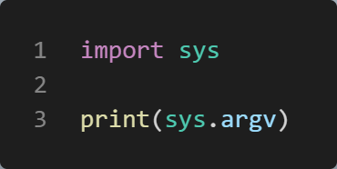
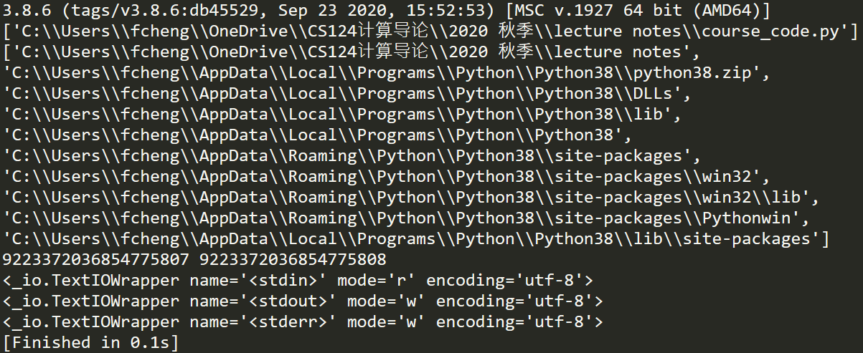
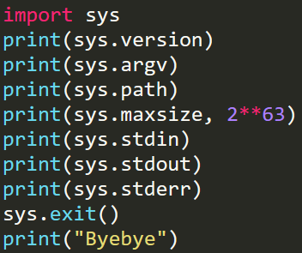
Module sys: Example
sys.argv: sys.argv returns a list of command line arguments passed to a Python script. sys.argv[0] contains the script file name xxx.py; sys.argv[1] contains the first parameter , while sys.argv[2] contains the second parameter
>>>python c.py a b c d
>>>[‘c.py', 'a', 'b', 'c', 'd']

Slide 27
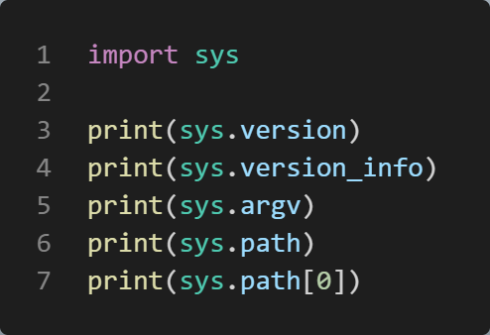
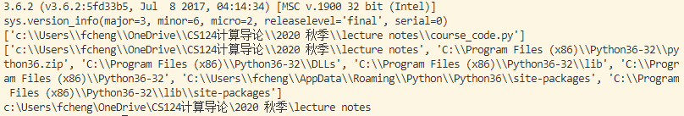
Module: sys.path
sys.path: This is an environment variable that is a search path for all Python modules.
A list of strings that specifies the search path for modules. Initialized from the environment variable PYTHONPATH, plus an installation-dependent default.
sys.path[0]: current directory of the file
As initialized upon program startup, the first item of this list, path[0], is the directory containing the script that was used to invoke the Python interpreter. If the script directory is not available (e.g. if the interpreter is invoked interactively or if the script is read from standard input), path[0] is the empty string, which directs Python to search modules in the current directory first. Notice that the script directory is inserted before the entries inserted as a result of PYTHONPATH.
绝对路径：sys.path[0] + 文件名

Slide 28
Module: standard streams
Every serious user of a UNIX or Linux operating system knows standard streams, i.e. input, standard output and standard error.
They are known as pipes.
They are commonly abbreviated as stdin, stdout, stderr.
The standard input (stdin) is normally connected to the keyboard, while the standard error and standard output go to the terminal (or window) in which you are working.
These data streams can be accessed from Python via the objects of the sys module with the same names, i.e. sys.stdin, sys.stdout and sys.stderr.
input(), print(), sys.stderr()

Slide 29
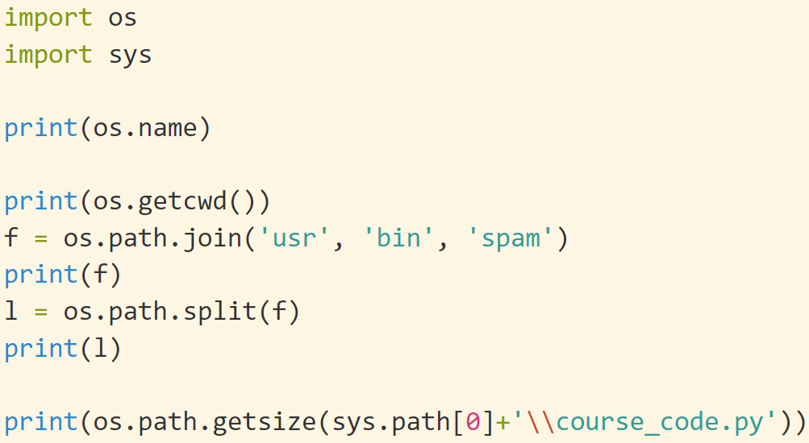
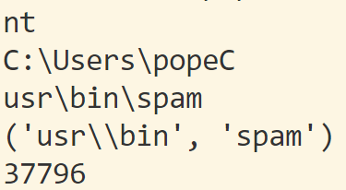
Module os 操作系统
OS: Operating system. This module provides a portable way of using operating system dependent functionality.
https://docs.python.org/3/library/os.html
os.name
os.environ, os.getenv() and os.putenv(): 环境变量
os.chdir() and os.getcwd(): 改变工作目录、查询当前目录
os.mkdir() and os.makedirs(): 创建目录
os.remove() and os.rmdir(): 删除文件、目录
os.rename(src, dst): 重命名
os.startfile(): 修改程序的 打开方式
os.walk()：遍历一个路径下面所有目录和文件
os.path
basename, dirname, exists, isdir and isfile, join, split
https://python101.pythonlibrary.org/chapter16_os.html
https://docs.python.org/3.3/library/os.path.html?highlight=path#module-os.path

Slide 30

File in Python
While a program is running, its data is stored in random access memory (RAM). RAM is fast and inexpensive, but when the program ends, or the computer shuts down, data in RAM will be lost
To make data available the next time the computer is turned on and the program is started, it has to be written to a non-volatile storage medium, such a hard drive, usb drive, or CD-RW
Data on non-volatile storage media is stored in named locations on the media called files
Working with files is a lot like working with a notebook
To use a notebook, it has to be opened
When done, it has to be closed
In python, a file object will be created to operate the file
open(filename, mode): returns a file object, default mode is “read”
close(): free up any system resources taken up by the open file
在 python 中，将创建一个文件对象来操作文件
open（filename， mode）： 返回一个文件对象，默认模式为 “read”
close（）：释放打开的文件占用的所有系统资源
所有文件都是二进制存储的: 二进制文件
把单个字节(Byte)的0/1串和人类可读的文字一一对应上来$→$ 文本文件
0/1串可以有任意多种文字的解读，ASCII只是其中一种

Slide 31
File Mode: Text and Binary
Text mode implies str objects, and binary mode implies bytes objects:
Text-mode files interpret file contents according to a Unicode encoding—either the default for your platform, or one whose name you pass in. By passing in an encoding name to open, you can force conversions for various types of Unicode files.
Textmode files also perform universal line-end translations: by default, all line-end forms map to the single '\n' character in your script, regardless of the platform on which you run it. As described earlier, text files also handle reading and writing the byte order mark (BOM) stored at the start-of-file in some Unicode encoding schemes.
Binary-mode files instead return file content to you raw, as a sequence of integers representing byte values, with no encoding or decoding and no line-end translations.
文本模式隐含 str 对象，二进制模式隐含 bytes 对象：
文本模式文件根据 Unicode 编码解释文件内容，Unicode 编码可以是平台的默认编码，也可以是您传入其名称的编码。通过传入要打开的编码名称，可以强制转换各种类型的 Unicode 文件。
文本模式文件还执行通用行尾转换：默认情况下，所有行尾窗体都映射到脚本中的单个“\n”字符，而不管运行它的平台如何。如前所述，文本文件还处理读取和写入某些 Unicode 编码方案中存储在文件开头的字节顺序标记 （BOM）。
相反，二进制模式文件以表示字节值的整数序列的形式将文件内容原始返回给您，没有编码或解码，也没有行尾转换。

Slide 32
open()
Syntax: open(file, mode='r', buffering=- 1, encoding=None, errors=None, newline=None, closefd=True, opener=None)
This function creates a file object, which would be utilized to call other support methods associated with it.
Here are parameter details −
file_name − The file_name argument is a string
access_mode − The access_mode determines the mode in which the file has to be opened, i.e., read, write, append, etc. This is an optional parameter, and the default file access mode is read (r).(决定文件打开模式)
Here is a list of the different modes of opening a file −
r: read; w: write; x: exclusive creation
b: binary; +: read and write; a: appending
Modes can be mixed
w mode: If the file is not existed, Python will create it. If not, Python will truncate the file first. ‘w’ mode is very dangerous as all the original data will be erased (可能删除已有文件)
'x’ open for exclusive creation, failing if the file already exists (Py 3.3+)
In text mode, if encoding is not specified the encoding used is platform-dependent: locale.getencoding() is called to get the current locale encoding. (For reading and writing raw bytes use binary mode and leave encoding unspecified.)
在文本模式下，如果未指定编码，则使用的编码与平台相关：调用 locale.getencoding（） 以获取当前语言环境编码。（对于读取和写入原始字节，请使用二进制模式，并保留未指定编码。
https://docs.python.org/3/library/functions.html#open

Slide 33
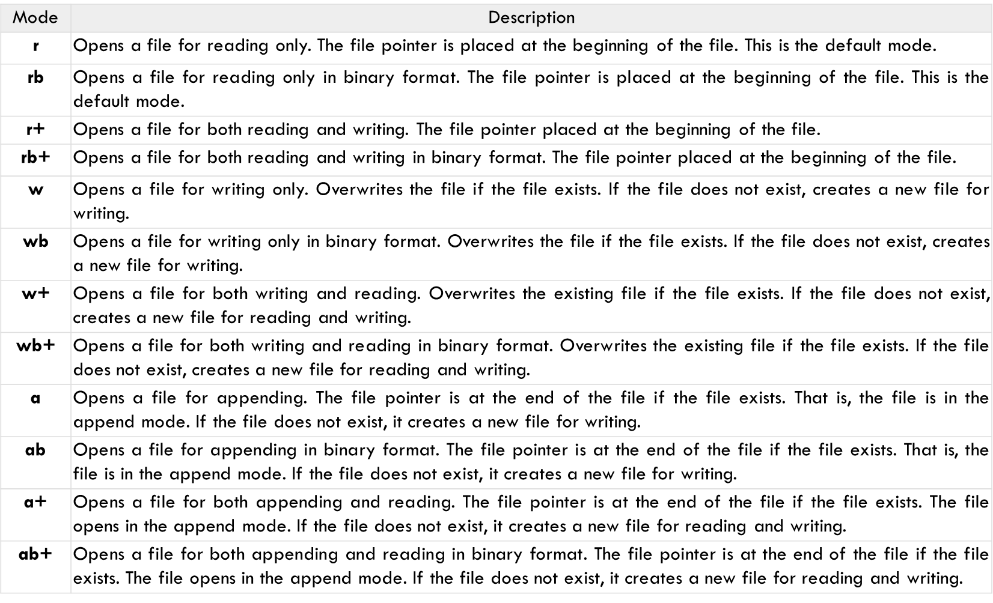

Slide 34
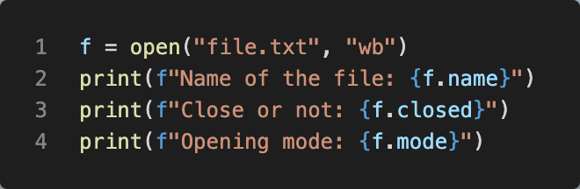

File object
Here is a list of all the attributes related to a file object
file.closed: Returns true if file is closed, false otherwise
file.mode: Returns access mode with which file was opened
file.name: Returns name of the file
文件常见错误
Python源文件和读写的文件不在同一个目录 (相对路径)
当前VS Code的工作目录和读写文件不同，特别注意 (绝对路径或者改变cwd)
再次强调：文件写w，要特别小心谨慎，数据保存和备份

Slide 35
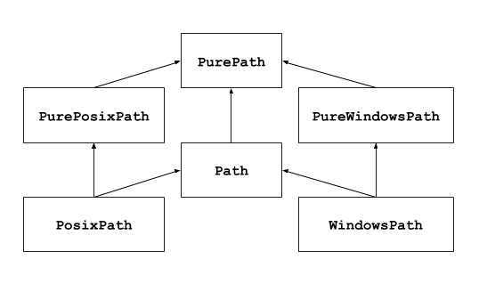
Path (路径): pathlib
Windows: C:\windows\xxxx\
Mac and Linux: C:/usr/xxxxx
历史遗留问题: early 1980’s computer history. By hand: No!
os.path: You can use os.path.join() to build a path string using the right kind of slash for the current operating system
pathlib: python 3.4
You should use forward slashes / with pathlib functions
The Path() object will convert forward slashes into the correct kind of slash for the current operating system. Nice!
If you want to add on to the path, you can use the / operator directly in your code. Say goodbye to typing out os.path.join(a, b) over and over
pathlib — Object-oriented filesystem paths 推荐使用
https://docs.python.org/3/library/pathlib.html 所有相关方法
Path, PosixPath, WindowsPath

Slide 36
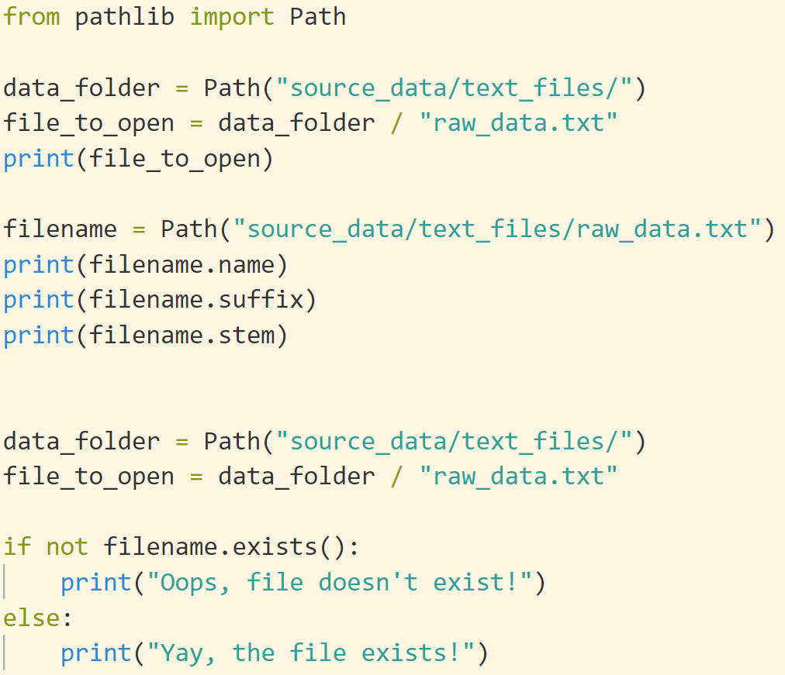
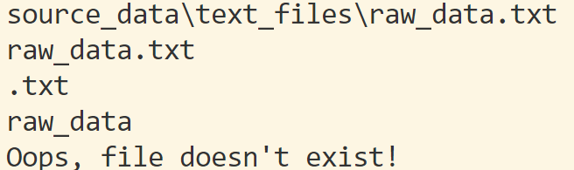
Path (路径): pathlib
直接用 “/”, 不需要考虑OS平台

Slide 37
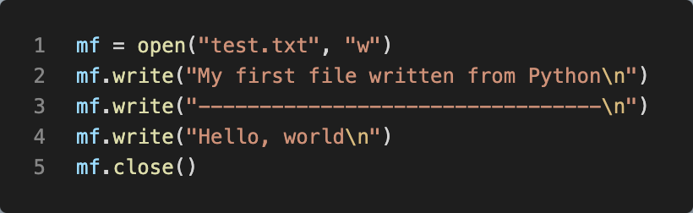
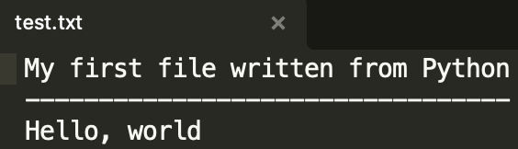
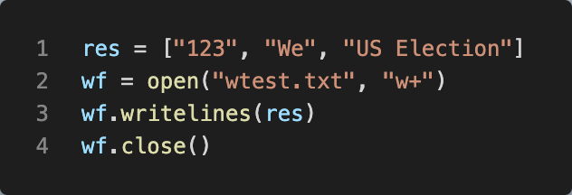

Write into Files: write(), writelines()
When you open() a file, do remember to close() it
A file object can call write() to write data into the file
f.write(string) writes the contents of string to the file, returning the number of characters written. The write() method does not add a newline character ('\n') to the end of the string
f.writelines (lines) Writes a list of lines to the file. Must be str. No “\n” added(lines是list, 里面元素是str)
With mode “w” (means write)
if there is no file named “test.txt” on the disk, it will be created.
If there already is one, it will be replaced by the file we are writing!!!!!!
Always open() and close() in pair

Slide 38
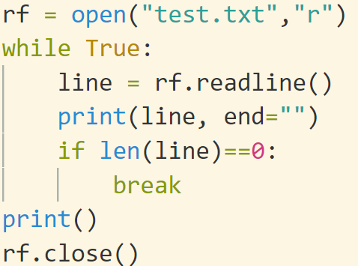
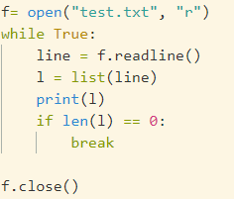
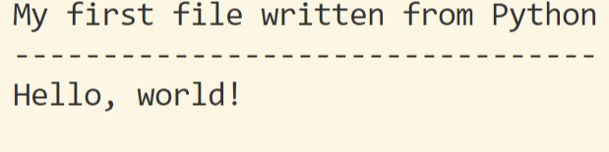
Read from files: read(), readline(), readlines()
There are three major methods to read from a file:
readline() method returns everything in “string” up to and including the newline character. ‘\n’ will be read in(一行行读)
input(): terminate when ‘\n’ is input and ‘\n’ is ignored
readlines(): Reads and returns a list of lines from the file. (返回一个元素是lines的列表)
read([n]) methods read n bytes from the file. To read a file’s contents, call f.read(size), which reads some quantity of data and returns it as a string (in text mode) or bytes object (in binary mode). (读n个字节的文本)
It is simple to transform a string into a list and see its contents

Slide 39
Binary files: read()
To read a file’s contents, call f.read(size), which reads some quantity of data and returns it as a string (in text mode) or bytes object (in binary mode).
size is an optional numeric argument. When size is omitted or negative, the entire contents of the file will be read and returned(不给定size则读出整个文本)
f = open("somefile.txt")
content = f.read()
f.close()
words = content.split()
print("There are {0} words in the file.".format(len(words)))
f = open("somefile.zip", "rb") # r: read; b: binary file
g = open("thecopy.zip", "wb") # w: write; b: binary file
while True:
buf = f.read(1024) # read 1024 bytes
if len(buf) == 0: # if buf is empty, then it is the end of the file.
break
g.write(buf)
g.close()
f.close()
https://docs.python.org/3/tutorial/inputoutput.html#reading-and-writing-files

Slide 40
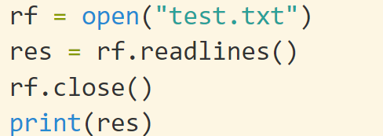
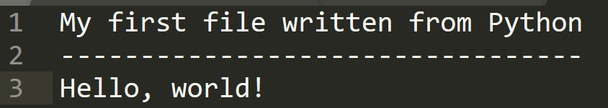
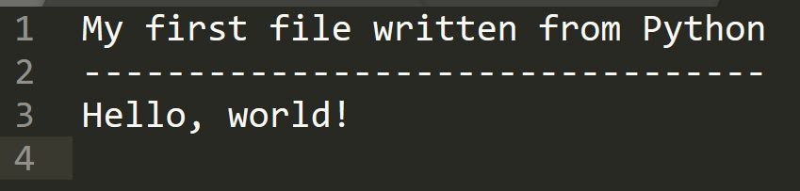
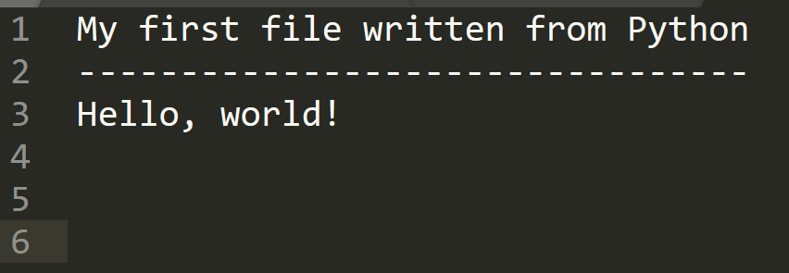
readlines() and EOF
readlines(): Reads and returns a list of lines from the file.
EOF: end of file. 文件结束标志
分别测试三种不同文件结尾

Slide 41
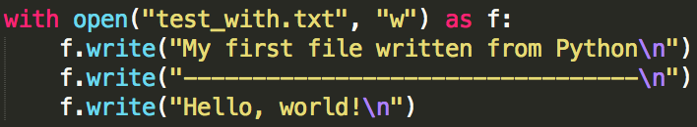
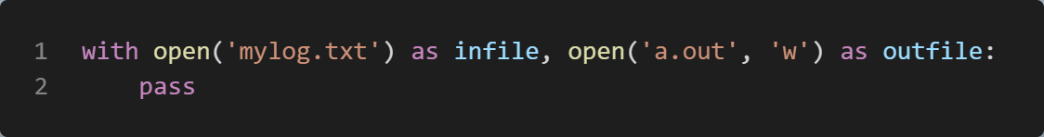
With statement(防止forget to close)
Forget close() is a common mistake in programming. The solution is to automatically call it
Python’s with statement provides a very convenient way of dealing with the situation where you have to do a setup and teardown to make something happen.
It is good practice to use the with keyword when dealing with file objects. The advantage is that the file is properly closed after its suite finishes, even if an exception is raised at some point
After a file object is closed, either by a with statement or by calling f.close(), attempts to use the file object will automatically fail
You won’t need to close() yourself. In fact, you cannot call close() now
with will be used repeatedly in other modules later
The syntax of the with statement now allows multiple context managers in a single statement:
一件事如果可能会做错，那么就一定会做错!
想不犯错？？不做open + close → with

Slide 42


File: iterable
We may use for to iterate a file just like processing a list/tuple/str/range
This approach is more Pythonic and can be quicker and more memory efficient. Therefore, it is suggested you use this instead.

Slide 43
Comments on write(), readline(), readlines()
Warning Calling f.write() without using the with keyword or calling f.close() might result in the arguments of f.write() not being completely written to the disk, even if the program exits successfully.
f.readline() reads a single line from the file; a newline character (\n) is left at the end of the string, and is only omitted on the last line of the file if the file doesn’t end in a newline. This makes the return value unambiguous; if f.readline() returns an empty string, the end of the file has been reached, while a blank line is represented by '\n', a string containing only a single newline.
writelines() does not add line separators. You can alter the list of strings by using map() to add a new \n (line break) at the end of each string
items = ['abc', '123', '!@#']
items = map(lambda x: x + '\n', items)
w.writelines(items)
with open(dst_filename, 'w') as f: #py 3.6
f.writelines(f'{s}\n' for s in lines)
警告 在不使用 with 关键字的情况下调用 f.write（） 或调用 f.close（） 可能会导致 f.write（） 的参数无法完全写入磁盘，即使程序成功退出也是如此。
f.readline（） 从文件中读取一行;换行符 （n） 保留在字符串的末尾，如果文件不以换行符结尾，则仅在文件的最后一行省略。这使得返回值明确无误;如果 f.readline（） 返回一个空字符串，则表示已到达文件的末尾，而空行由 'n' 表示，该字符串仅包含一个换行符。
writelines（） 不添加行分隔符。通过使用 map（） 在每个字符串的末尾添加新的 n（换行符）来更改字符串列表

Slide 44


tell(), seek() and flush()
f.tell() returns an integer giving the file object’s current position in the file represented as number of bytes from the beginning of the file when in binary mode and an opaque number when in text mode.
To change the file object’s position, use f.seek(offset, whence). The position is computed from adding offset to a reference point; the reference point is selected by the whence argument. A whence value of 0 measures from the beginning of the file, 1 uses the current file position, and 2 uses the end of the file as the reference point. whence can be omitted and defaults to 0, using the beginning of the file as the reference point.
f.flush()

Slide 45
Mixed read and write in the same file(总之不要同时读写)
The effect of mixing reads with writes on a file open for update is entirely undefined unless a file-positioning operation occurs between them (for example, a seek()).
Read after write: flush()
Write after read: seek()
test_read_write.py
For files open for appending (those which include a "+" sign), on which both input and output operations are allowed, the stream should be flushed (fflush) or repositioned (fseek, fsetpos, rewind) between either a writing operation followed by a reading operation or a reading operation which did not reach the end-of-file followed by a writing operation.
SO to summarize, if you need to read a file after writing, you need to fflush the buffer and a write operation after read should be preceded by a fseek, as fd.seek(0, os.SEEK_CUR)
https://stackoverflow.com/questions/14279658/mixing-read-and-write-on-python-files-in-windows
https://stackoverflow.com/questions/14271216/beginner-python-reading-and-writing-to-the-same-file
https://cplusplus.com/reference/cstdio/fopen/

Slide 46
Reading
Ch 37 Unicode and Byte Strings
https://realpython.com/read-write-files-python/

